Slide 1



Power BI Project
Presentation
Presented by Jeya Raman Sekar

Slide 2

Power BI Project
Presentation
Walmart Store

Slide 3








Introduction
Walmart is a global retail giant that has transformed the way we shop. Founded in 1962 by Sam Walton in Rogers, Arkansas, Walmart has grown from a single discount store to the largest retailer in the world.
With over 11,000 stores in 27 countries and e-commerce platforms serving millions, Walmart's mission is to help people save money and live better.

Slide 4
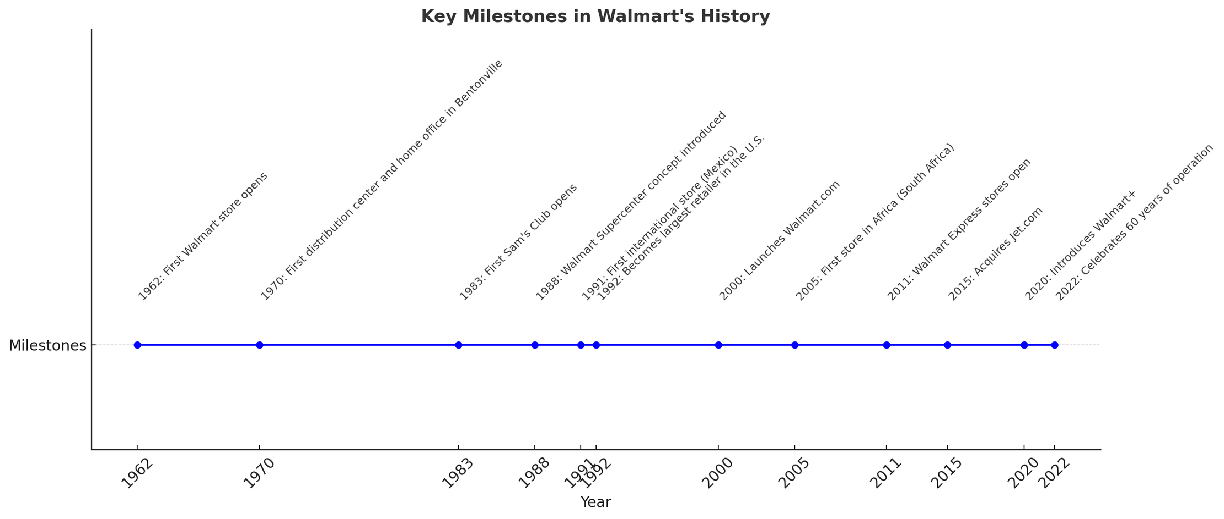
Walmart History

Slide 5
Competitors
Amazon: As the largest e-commerce platform globally, Amazon poses a substantial threat with its vast product range, fast delivery services, and Prime membership benefits. However, when it comes to physical store presence, Amazon's stores are relatively fewer and not as widespread.
Target: Known for its trendy merchandise and strong brand loyalty, Target attracts a different demographic. While Target stores often provide a more aesthetically pleasing shopping experience.

Slide 6
Problem Statement
Despite these competitors, Walmart continues to dominate due to its expansive physical presence, competitive pricing, and commitment to helping customers save money and live better.
However, it is crucial to acknowledge that some customers perceive the quality of Walmart's stores as lacking compared to its competitors, citing issues such as store cleanliness and customer service.

Slide 7
Analyzing Sales Data
Walmart has recognized the importance of leveraging data analytics to stay ahead in the competitive retail market. By analyzing their vast sales data, Walmart aims to gain valuable insights that can drive strategic decisions and enhance customer experiences.

Slide 8
Objectives of Analyzing Sales Data
Understanding Customer Behavior: By examining purchasing patterns, Walmart can better understand customer preferences and tailor their inventory accordingly.
Optimizing Inventory Management: Data analytics helps Walmart predict demand more accurately, reducing stockouts and overstock situations.

Slide 9
Objectives of Analyzing Sales Data
Personalizing Marketing Strategies: Insights from sales data enable Walmart to create targeted marketing campaigns, offering personalized promotions and recommendations to customers.
Enhancing Store Operations: Analyzing data on sales performance across different stores helps identify best practices and areas needing improvement, leading to more efficient store operations.

Slide 10
Power BI Data
Modeling
Data Relationship Building

Slide 11
Data Modeling
I began by downloading the CSV file from the provided link and converted it into an Excel format. Next, I uploaded the Excel file into Power BI. After loading the data, I performed data cleaning using the 'Transform Data' feature. Following that, I split the single sheet into four separate tables to better organize the data. Once the cleaning process and data organization were complete, I proceeded to create data models and defined relationships between the different datasets. Finally, I reviewed the writing for grammar and clarity in preparation for the presentation.

Slide 12
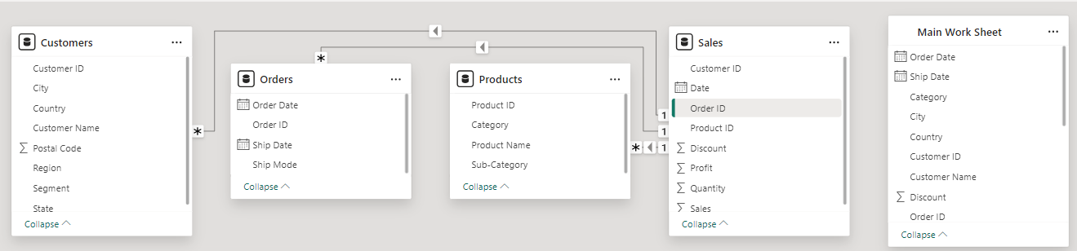
Data Modeling

Slide 13
Power BI Data
Visualization
Profit Prediction – Power Analysis

Slide 14
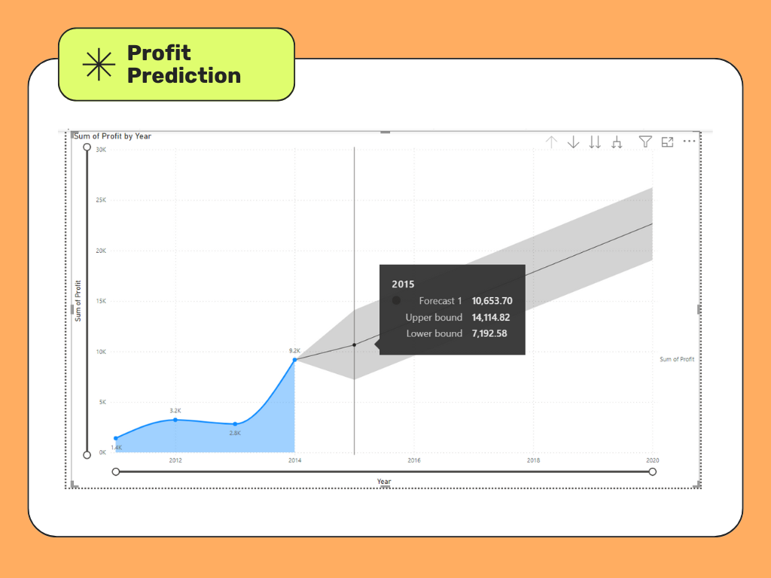
Profit Prediction – Power Analysis

Slide 15
Line Chart Analysis
Using Line Chart Analysis: Predicted the profit for upcoming years using the forecast option.
Historical Data: 2011-2014
Forecast Year: 2015
Predicted Profit: 10,653.70 (Forecast1 indicates the average expected profit)
Upper Bound: 14,114.82 (Maximum expected profit.)
Lower Bound: 7,192.58 (Minimum expected profit.)
X-Axis: Year Y-Axis: Profit

Slide 16
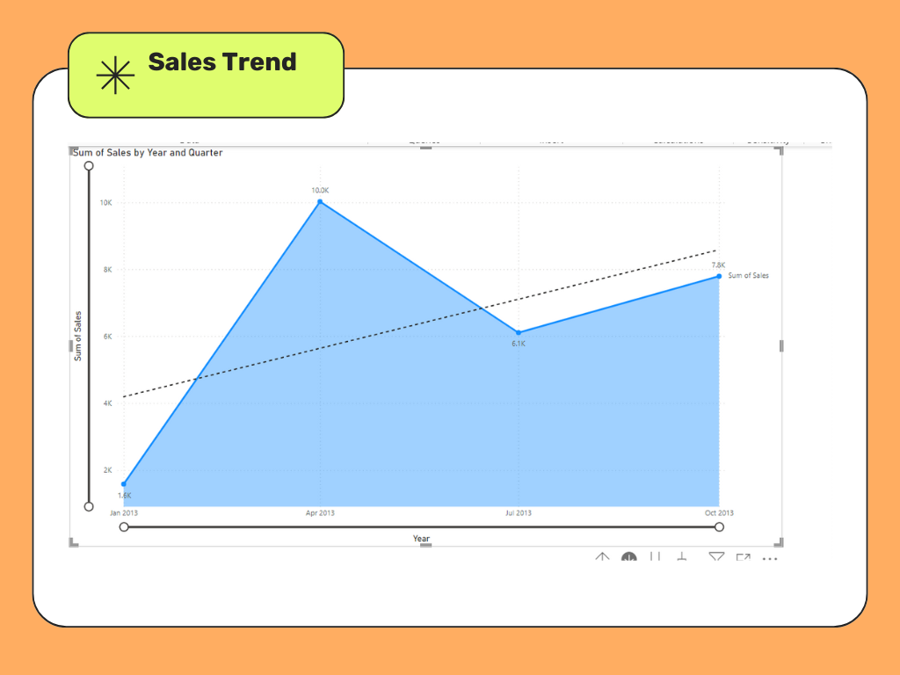
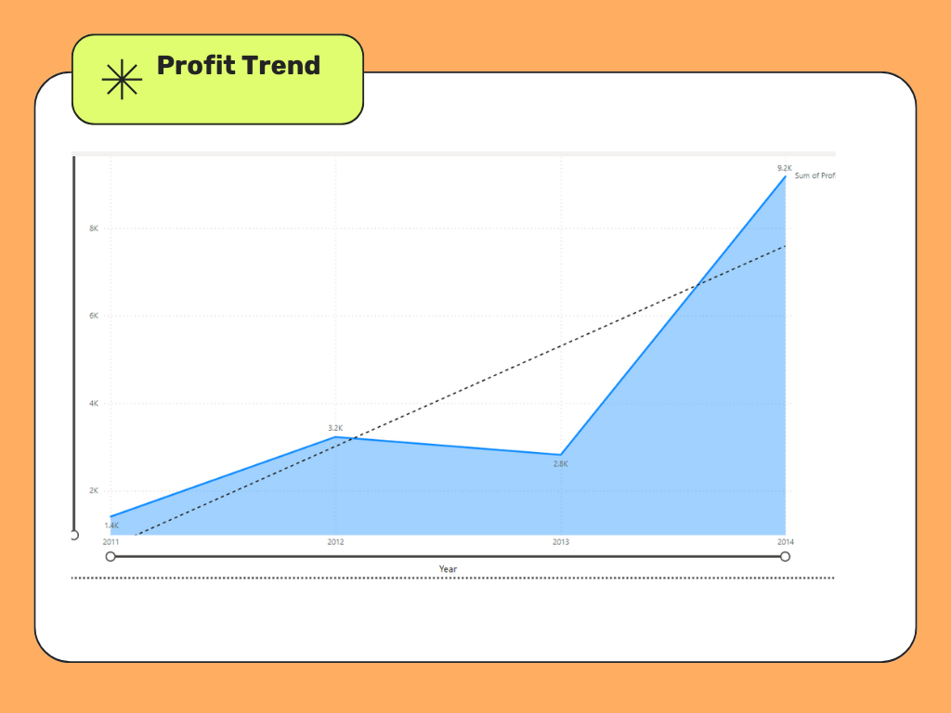
Area Chart Analysis

Slide 17
Area Chart Analysis
Area Chart Explanation
Data Represented:
Sales Analysis: Area chart displaying sales trends over time.
Profit Analysis: Area chart showing profit trends over time.
Key Insights:
Helps in identifying the growth trends in sales and profit.
Visualizes the relationship between sales and profit, highlighting periods of significant growth or decline.

Slide 18
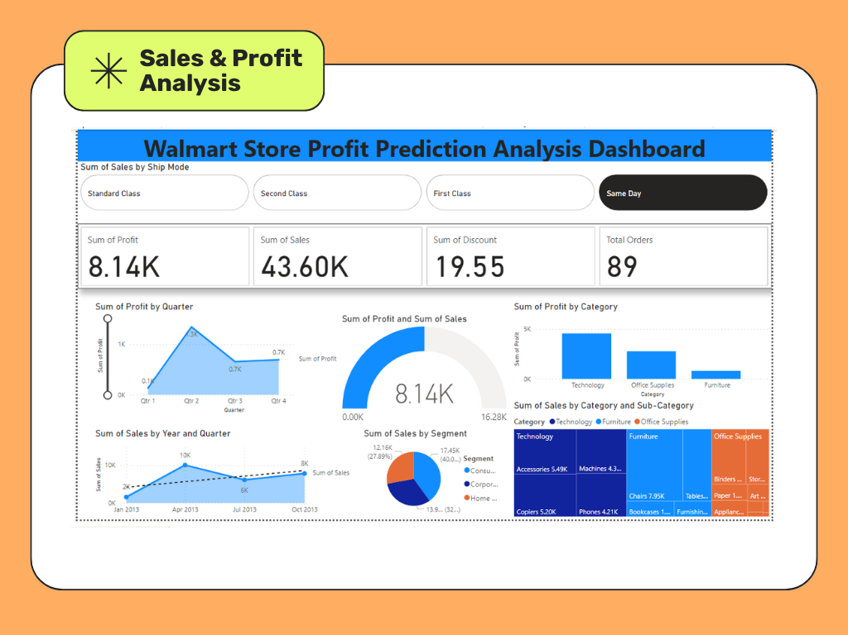
Dashboard Analysis

Slide 19
Dashboard Analysis
Dashboard Overview
Components:
Sales Analysis: Area chart displaying sales trends over time.
Profit Analysis: Area chart showing profit trends over time.
Combined Analysis: Dashboard integrating both sales and profit data for a comprehensive view.
Key Insights:
Identifies peak sales and profit periods.
Highlights the correlation between sales and profit growth.
Aids in strategic planning and decision-making based on historical data trends.

Slide 20
Power BI Data
Visualization
Pareto Chart Analysis

Slide 21
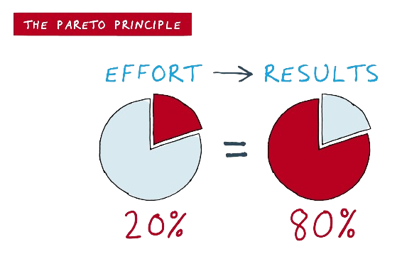

Pareto Chart Analysis

Slide 22
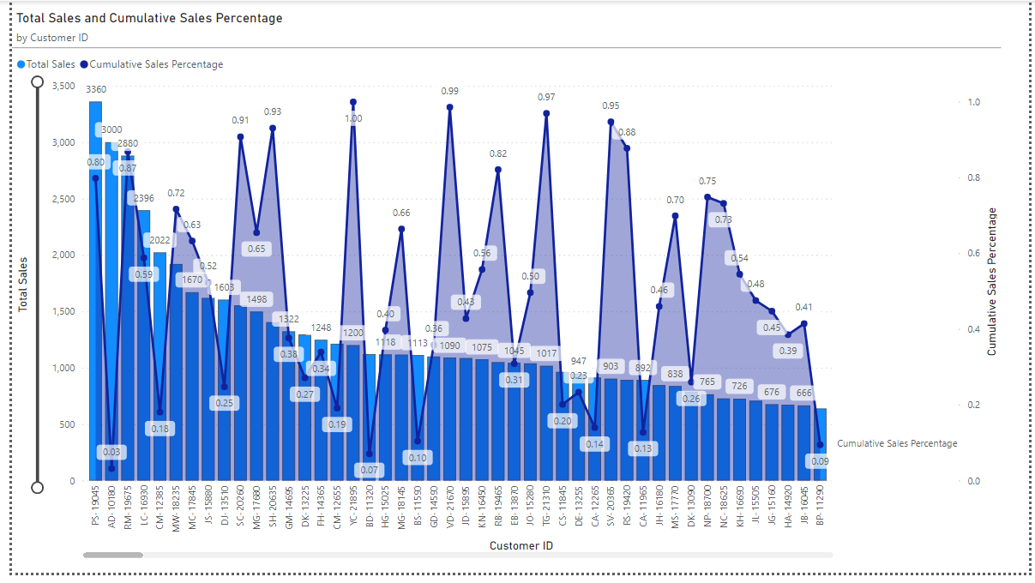
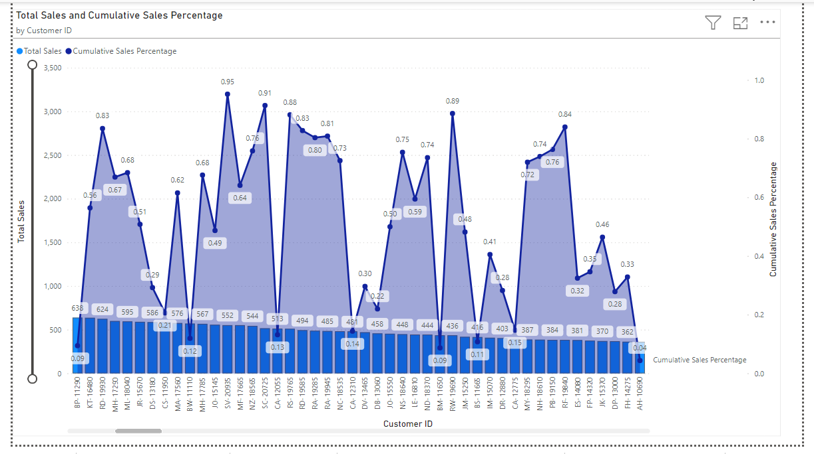
Pareto Chart Analysis

Slide 23
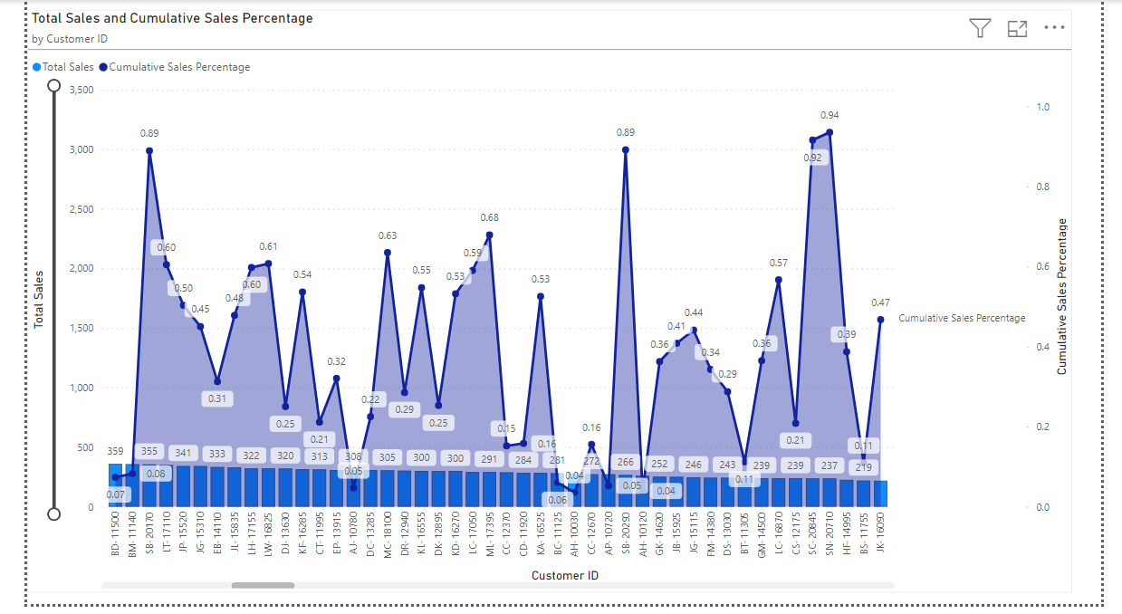
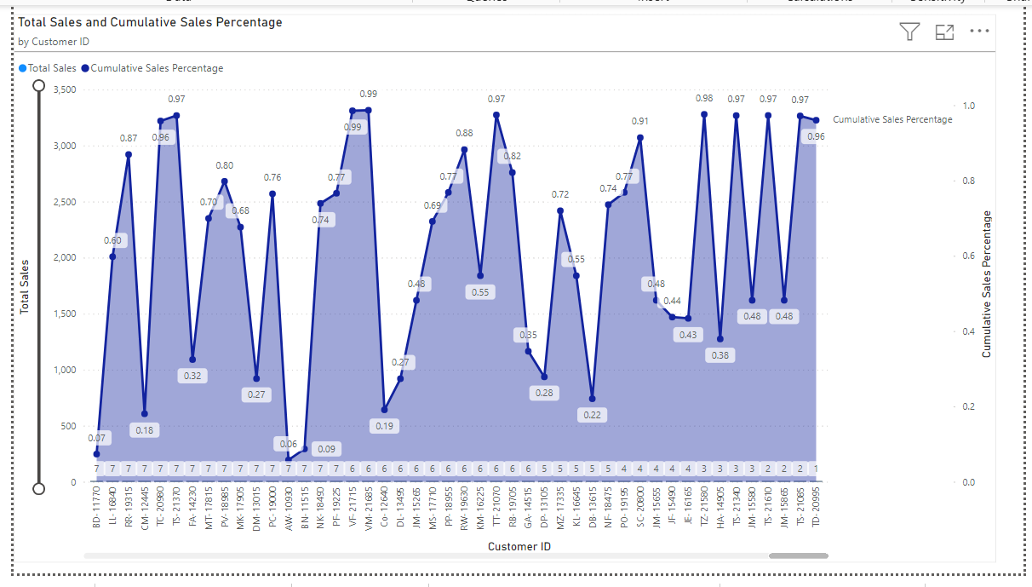
Pareto Chart Analysis

Slide 24
Pareto Chart Analysis
The Pareto Chart in Power BI identifies the most significant factors affecting sales and profit, following the 80/20 rule, where 80% of effects come from 20% of causes.
I created a Pareto Chart by calculating new measures like cumulative sales and cumulative sales percentage. Initially, I selected the clustered column chart with the following settings:
X-Axis: Customer ID
Y-Axis: Total Sales.
Secondary Y-Axis: Cumulative Sales Percentage

Slide 25
Pareto Chart Analysis
After generating the report, I sorted the data in descending order by total sales. This visualization helps to identify the top customers contributing to the majority of sales, adhering to the 80/20 rule and provides a strategic focus for maximizing returns and optimizing resource allocation.

Slide 26
Power BI Data
Visualization
Sales & Revenue Analysis

Slide 27


Sales & Revenue Analysis

Slide 28
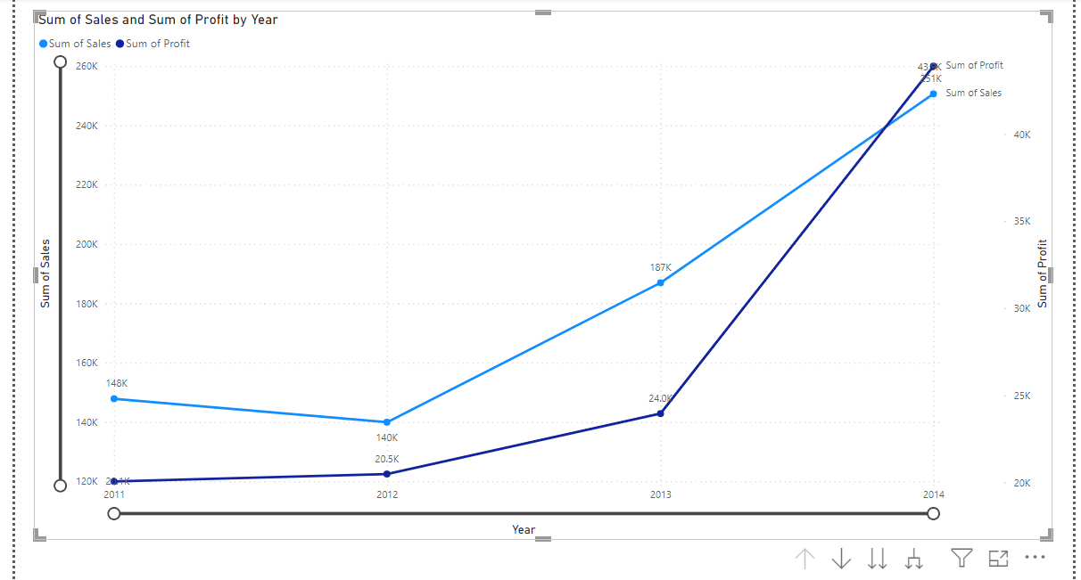
Sales & Revenue Analysis

Slide 29
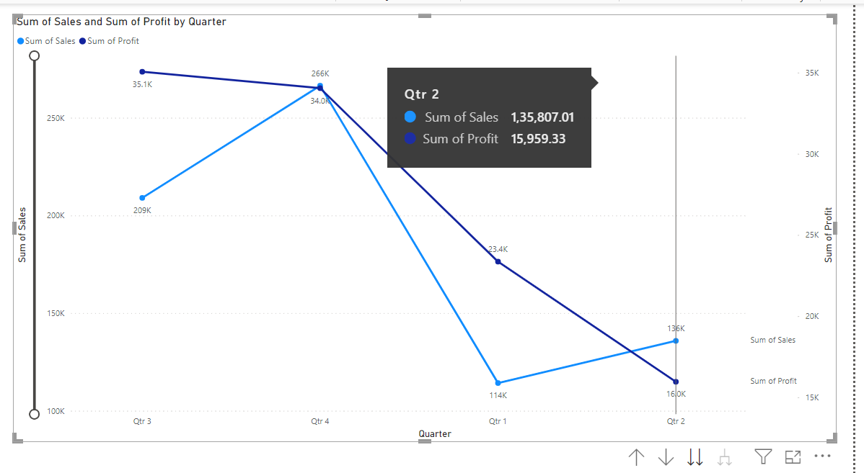
Sales & Revenue Analysis

Slide 30
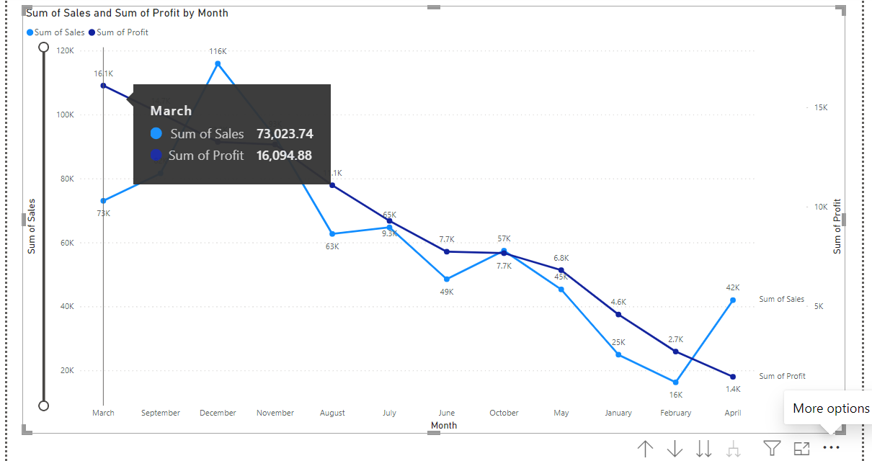
Sales & Revenue Analysis

Slide 31
Sales & Revenue Analysis
Objective: Analyze sales and revenue trends over different periods.
X-Axis: Year Primary Y-Axis: Total Sales Secondary Y-Axis: Profit
Time Period Analysis
Year-wise Chart: Shows annual trends in sales and profit.
Quarter-wise Chart: Highlights seasonal variations and quarterly performance.
Month-wise Chart: Provides detailed monthly insights into sales and profit fluctuations.
Key Insights:
Trend Identification: Yearly, quarterly, and monthly trends reveal patterns and performance peaks.
Correlation Analysis: Compare sales and profit to understand profitability relative to sales.
Strategic Planning: Use trends to forecast future performance and inform business strategies.

Slide 32
Power BI Data
Visualization
Inventory Analysis

Slide 33
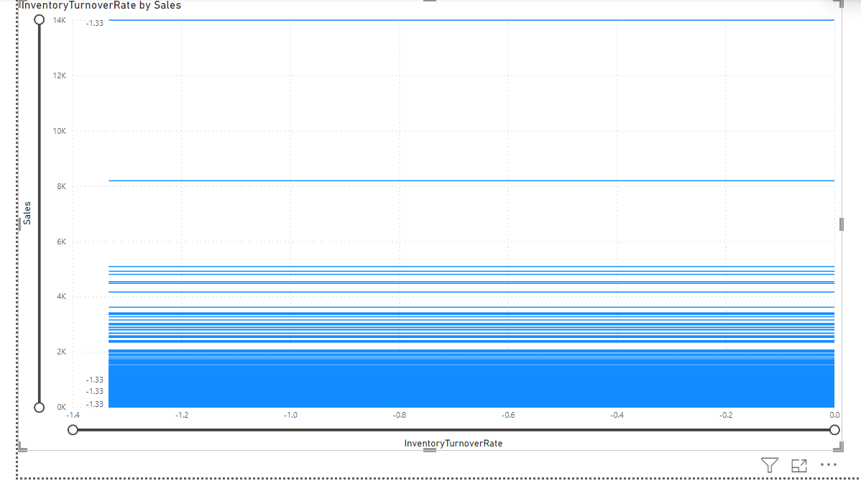
Inventory Analysis

Slide 34
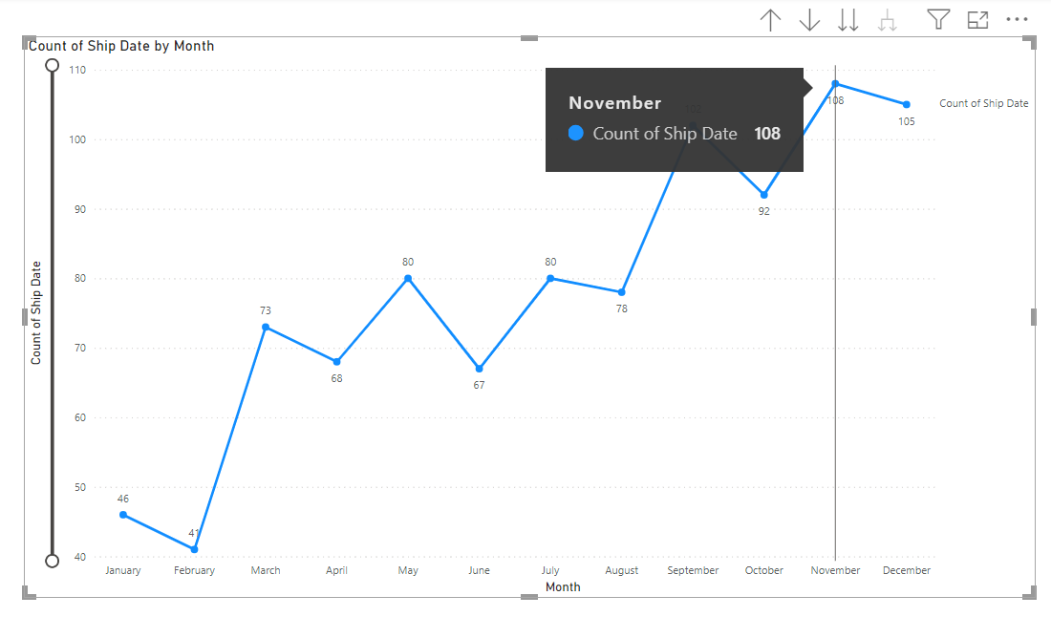
Inventory Analysis

Slide 35
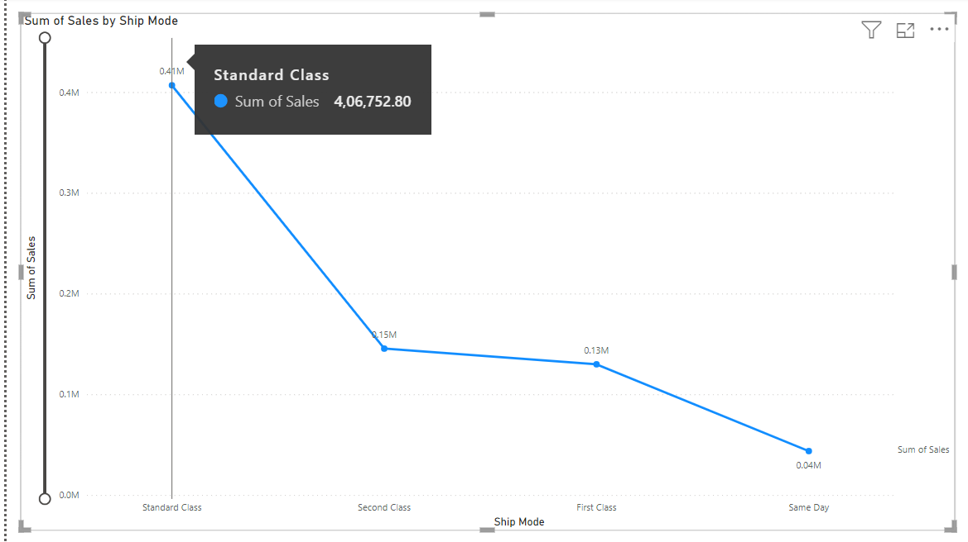
Inventory Analysis

Slide 36
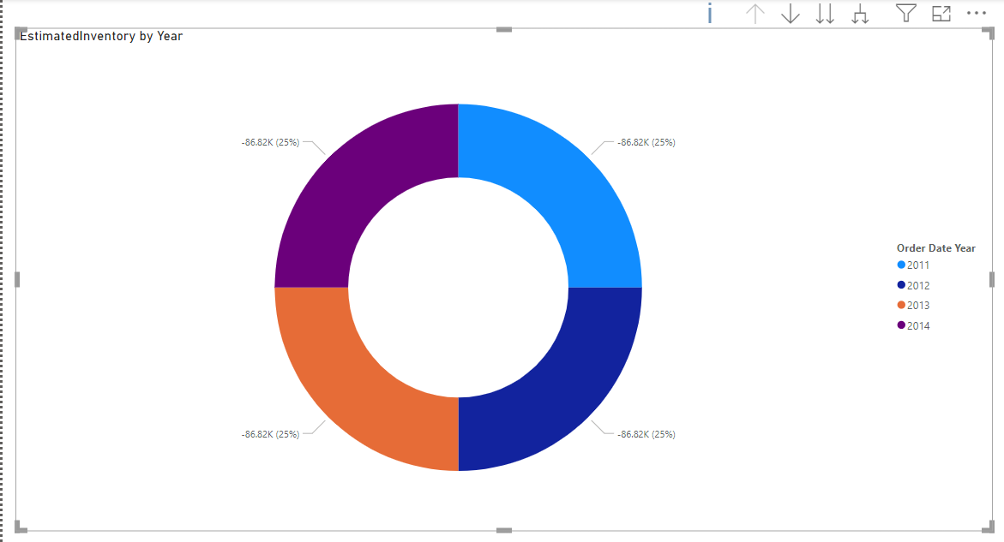
Inventory Analysis

Slide 37
Inventory Analysis
Inventory Management and Order Fulfillment
Objective: Analyze inventory management efficiency and order fulfillment.
Key Measures
Average Inventory: Calculated to understand the typical inventory level.
Estimated Inventory: Projected inventory based on historical data and trends.
Inventory Turnover Rate: Measure of how quickly inventory is sold and replaced.
Strategic Insights:
Inventory Turnover Rate: Helps in understanding inventory liquidity and optimizing stock levels.
Ship Mode Analysis: Identifies the most efficient shipping methods to improve customer satisfaction and reduce costs Forecasting: Use estimated inventory trends to plan future inventory needs and improve order fulfillment processes..

Slide 38
Power BI Data
Visualization
Customer Analysis

Slide 39
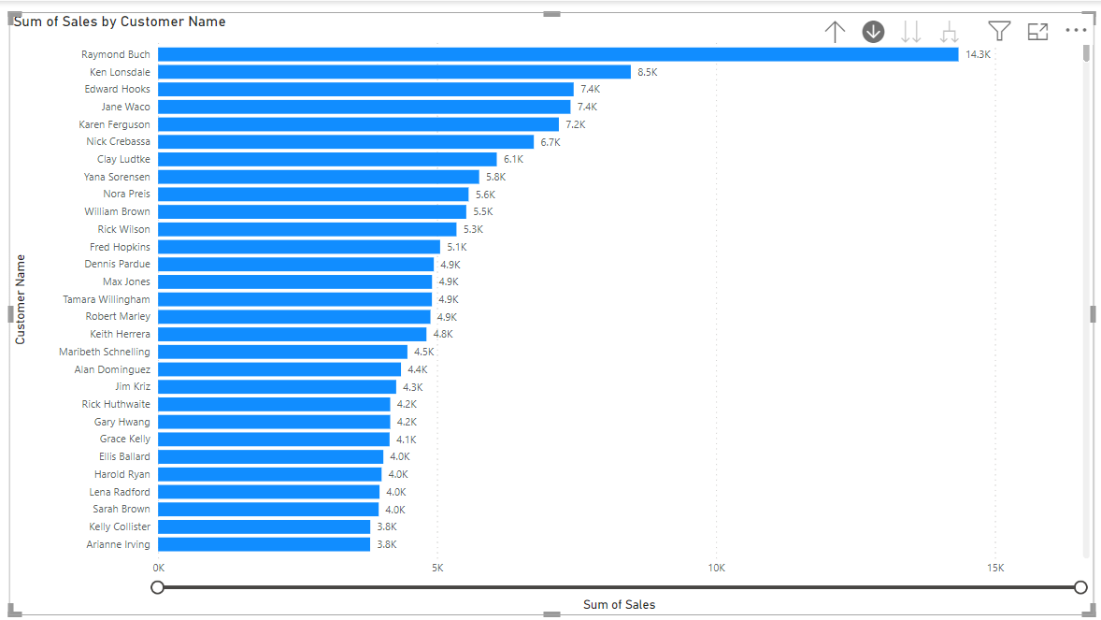
Customer Analysis

Slide 40
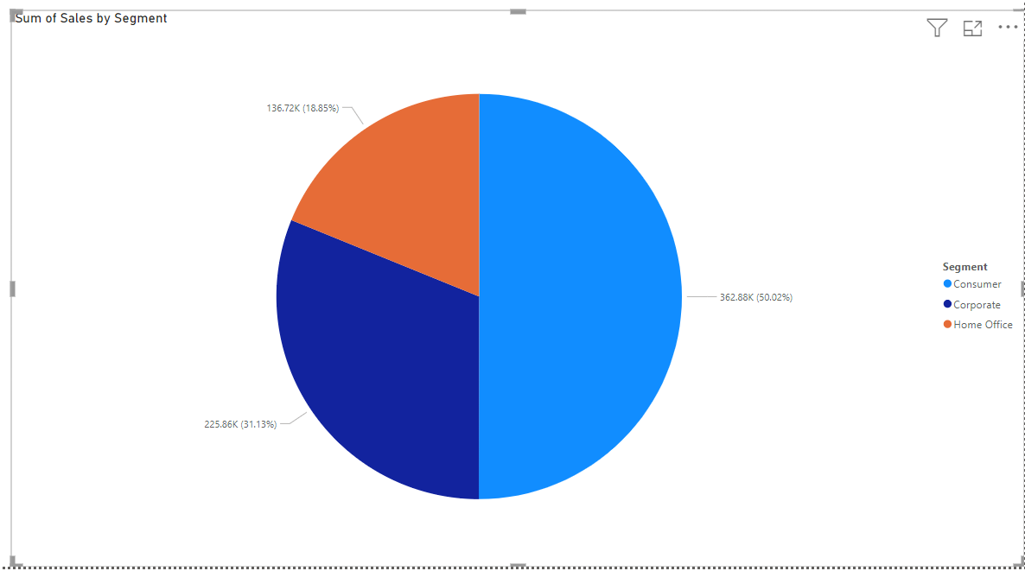
Customer Analysis

Slide 41
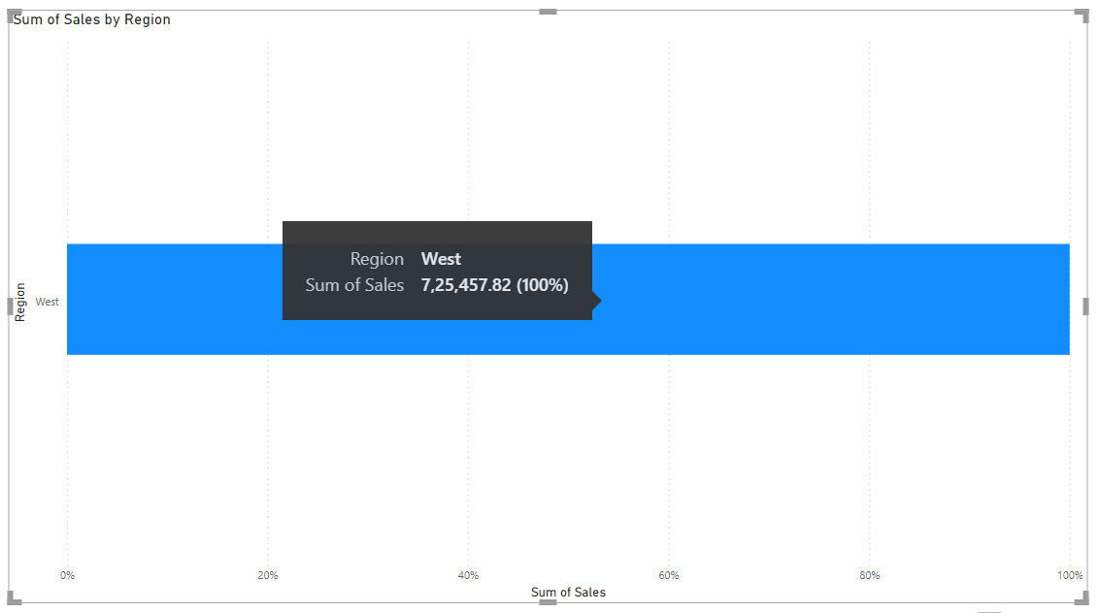
Customer Analysis

Slide 42
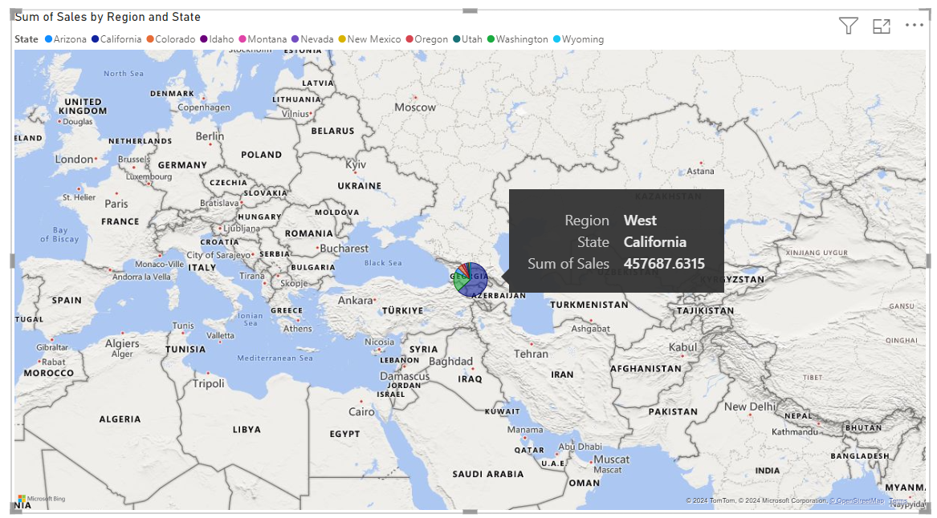
Customer Analysis

Slide 43
Customer Analysis
Customer Insights Analysis
Objective: Understand customer behavior and performance through various analyses.
Key Analyses
Top Customers by Sales:
Identified top-performing customers based on total sales
Highlights key customers contributing the most to revenue.
Customer Segmentation:
Categorized customers into segments based on purchasing behavior, demographics, or other criteria.
Enables targeted marketing strategies and personalized customer engagement.
Customer Region Visualizations: Here 100% west Region

Slide 44
Customer Analysis
Key Insights
Top Customers by Sales:
Focus on high-value customers to maximize revenue and foster loyalty.
Customer Segmentation:
Tailor marketing and sales efforts to different customer segments for better engagement and conversion rates.
Customer Region Visualizations:
Optimize resource allocation and marketing strategies based on regional performance.

Slide 45
Power BI Data
Visualization
Store Performance Analysis

Slide 46
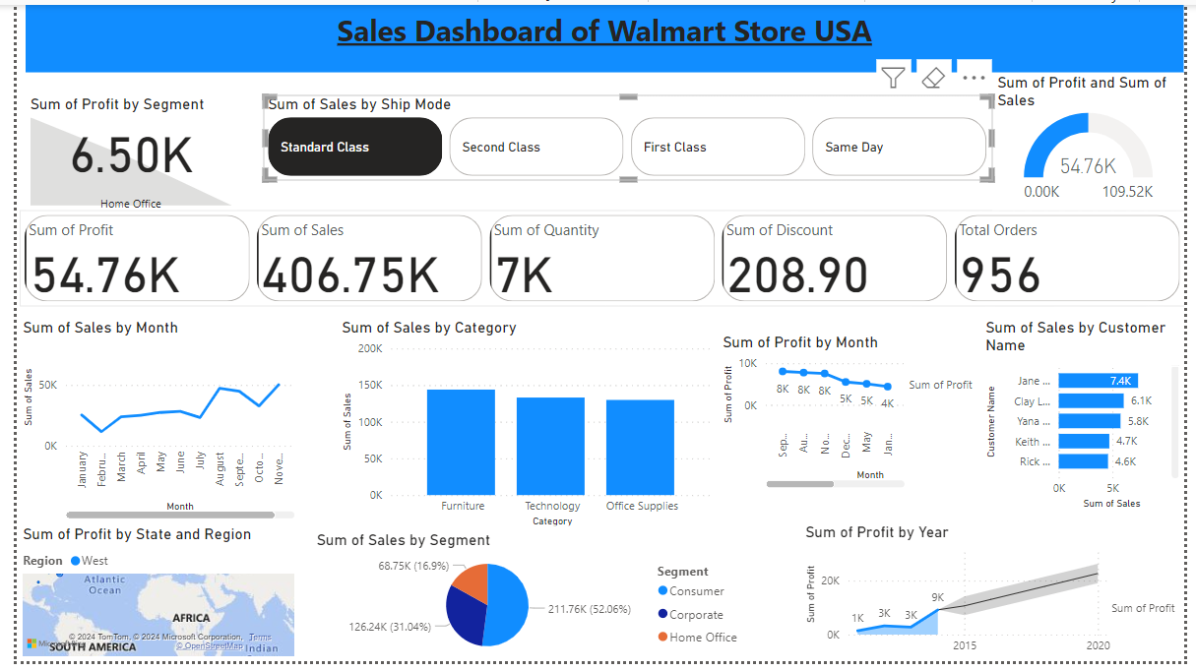
Store Analysis

Slide 47
Store Analysis
Store Performance Dashboard Overview
Objective: Provide a comprehensive view of store performance through various analyses.
Dashboard Components
Reports Included:
Sales Analysis: Visualizes total sales over time.
Customer Analysis: Breaks down customer demographics and behaviors.
Profit Analysis: Examines profit margins and trends.

Slide 48
Store Analysis
Interactive Elements
Cards: Display key metrics such as: Total Profit
Total Sales
Quantity Sold
Total Discount
Total Orders
Slicers:
Ship Mode (Standard, First Class, Second Class, Same Day)
Advanced Visuals:
KPI Profit by Segment:
Gauge Report:

Slide 49
Store Analysis
Key Insights
Comprehensive View: Integrates multiple reports for an all-encompassing performance analysis.
Interactivity: Users can interact with slicers and cards to filter and focus on specific data points.
Performance Metrics:
Quickly assess store performance with key metrics and advanced visuals.

Slide 50
Power BI Data
Visualization
Root Cause Analysis

Slide 51
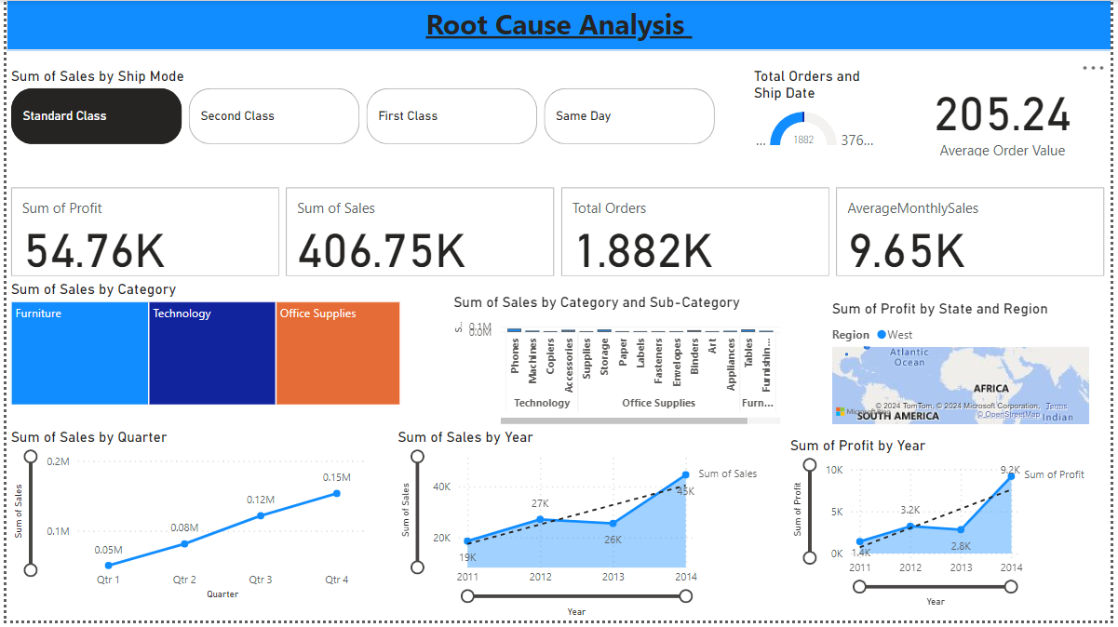
RCA Analysis

Slide 52
RCA Analysis
Overview
The Root Cause Analysis (RCA) report provides a comprehensive view of key performance metrics and insights to help identify underlying factors affecting business performance.
This report consolidates various analyses into a single, interactive dashboard for better data visualization and decision-making.

Slide 53
RCA Analysis
Key Analyses
Sales Analysis: Visual representation of total sales over time to identify trends and patterns.
Orders Analysis: Breakdown of total orders, providing insight into customer purchasing behavior.
Profit Analysis: Examination of profit margins across different dimensions.
Ship Date Analysis: Analysis of shipping dates to understand logistics performance and delivery timelines.

Slide 54
RCA Analysis
Key Analyses
Sales by Category: Categorized sales data to highlight performance across different product categories.
Profit by State and Region: Geographical breakdown of profit to identify high-performing and underperforming areas.
Yearly Trends: Year-over-year comparison to track growth and performance changes.

Slide 55
Interactive Elements
Cards:
Total Profit
Total Sales
Total Orders
Average Monthly Sales
Slicers:
Standard Class
First Class
Second Class
Same Day
RCA Analysis

Slide 56
RCA Analysis
Interactive Elements
KPIs:
Average Order Value: Tracks the average value of each customer order.
Gauge Report: Visualizes total orders and ship dates to assess performance against targets.
Key Insights
Sales and Profit Trends: Identify seasonal trends, peak sales periods, and areas needing improvement.
Order and Shipment Analysis: Understand the efficiency of order fulfillment and shipping processes.

Slide 57
RCA Analysis
Key Insights
Category Performance: Determine which product categories contribute most to sales and profit.
Geographical Insights: Pinpoint states and regions with the highest and lowest profitability to tailor regional strategies.
Interactive Filtering: Utilize slicers to drill down into specific segments and uncover detailed insights.

Slide 58

Q & A Time

Slide 59


